Slide 1
TRAUMA INFORMED SCHOOLS: A JOURNEY
Joe Fantigrossi, Ed.D., Pre K-12 Intervention Coordinator, Lyons CSD
Jay Roscup, Consortium Grants Administrator, Lyons CSD

Slide 2
TRAUMA IS NOT THE EVENT.
TRAUMA IS THE RESPONSE.
EACH INDIVIDUAL RESPONSE TO CHRONIC OR ACUTE STRESS DETERMINES THE LEVEL OF TRAUMATIC IMPACT.
STOP ASKING: What is wrong with this student?
AND START ASKING: What has happened to this student?

Slide 3
Today’s Purpose
For participants to:
Gain a cursory understanding of the impacts of childhood trauma,
See how trauma awareness can work collaboratively with their current instructional and intervention systems,
and come away with a collection of recommended resources and practices for both systems and classroom work.

Slide 4
Takeaways
1. Robust list of digital and traditional resources for research, book study, and implementation.
2. Collection of strategies to both recognize and respond to students who have experienced significant trauma.
3. Methods of supporting staff in meeting the needs of students impacted by trauma.

Slide 5
ACES
ACE’s STUDY
TOXIC IMPACT OF STRESS
NEUROLOGY
IMPACT ON BIOLOGY/PHYSICAL HEALTH
NEED FOR A ‘PUBLIC HEALTH RESPONSE’

Slide 6
ADVERSE CHILDHOOD EXPERIENCES:
Adverse Childhood Experiences (ACEs) - potentially traumatic events with negative, lasting effects on health and well-being
HANDOUT
ABUSE
NEGLECT
DYSFUNCTION (Family)

Slide 7
Why is this important?

Slide 8
Small Group Activity
At your tables, quietly read the handout provided at your table (Reading 1 or Reading 2)
After finishing the reading, discuss the points you felt were most important or meaningful to you with 1 or 2 other people at your table
Next, find someone from a table that read the other handout and share the most important points with them
Finally, return to your original seat for a whole group debriefing exercise

Slide 9
WE BEGAN TO UNDERSTAND TO BE “CULTURALLY EQUITABLE, VALID, KNOWLEDGEABLE & RELEVANT” MEANT WE HAD TO BE TRAUMA INFORMED……

Slide 10
PBIS article:
Article broken into 4 chunks
Each table assigned a chunk
Read silently, then discuss at table
Representatives from each chunk come together to form new groups and discuss
Generate content for a similar article on RtI in original group
“Using PBIS to Help Schools Become More Trauma-Sensitive”-Wisc. Dept. of Public Instruction

Slide 11
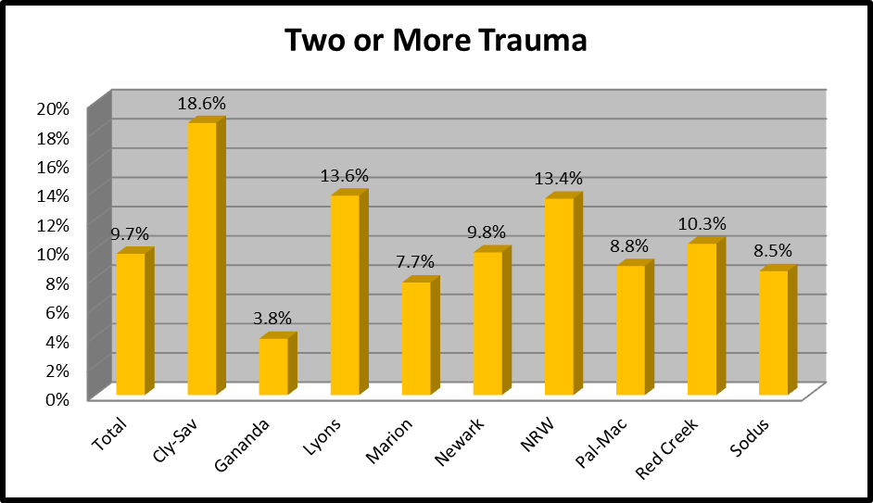
ACE’S REPORTED BY KINDERGARTEN Parents AT SCREENING:
Adverse Childhood Experiences that families commonly encounter.
How many of the following events have happened to or around this child:
-death of a parent
-parental divorce or separation
-incarceration of a parent
-drug or alcohol abuse
-mental health problems
-domestic violence
-physical neglect
-emotional neglect
-physical abuse
-emotional abuse
-sexual abuse
K READY SURVEY- Wayne County 2016
554 out of 1007 Kindergarten Students

Slide 12
LOCAL K SCREEN: Children with 2 or more “ACE” *:
3 times more likely to not calm down when upset.
Twice as likely to rarely play with children outside the family.
Twice as likely to not be able to independently button or zipper clothing.
13 times less likely to be able to focus on activity other than TV or computer.
Less than half as likely to have been breastfed for more than 6 months.
* AS REPORTED BY REGISTRANT

Slide 13
LOCAL K SCREEN: Children with 2 or more “ACE” *:
7 times more likely to have moved four or more times.
More than twice as likely to spend less than 3 hours a week in family activity.
2.5 times less likely to have a set bedtime.
5.7 times more likely to ignore rules at home.
4.3 times more likely to never read with parent/adult.
* AS REPORTED BY REGISTRANT

Slide 14
CAMI- Control Agency MeANS/END InveNTORY
First is “Control” beliefs that is, the general perception that one has control over outcomes in one’s life.
The second is “Agency” beliefs, that is, the degree to which agents, e.g. one’s self, can control outcomes.
The third is “Means-Ends” beliefs or the belief that having and/or using certain means will affect an outcome.
These concepts depend on the underlying belief that one can control or influence outcomes. The CAMI includes 10 scales addressing Control, Means-end and Agency. Within Means-ends and Agency there are scales for the specific concepts of effort, attributes, powerful others, luck and unknown factors.
Validated Scales for Self-Efficacy

Slide 15
TRAUMA DISRUPTS SELF-EFFICACY:

Slide 16
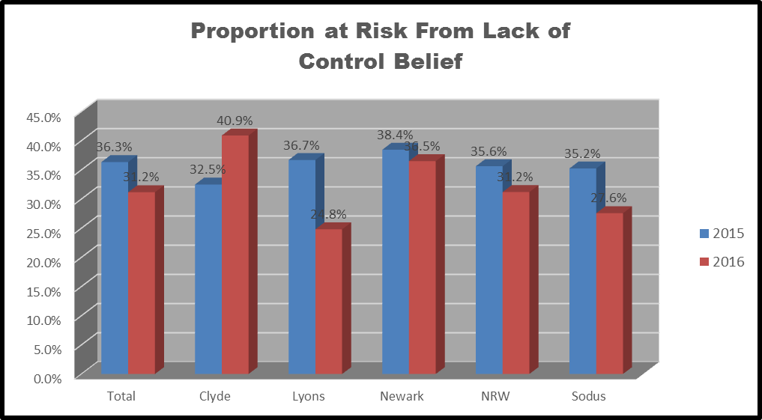
TRAUMA DISRUPTS SELF-EFFICACY:

Slide 17
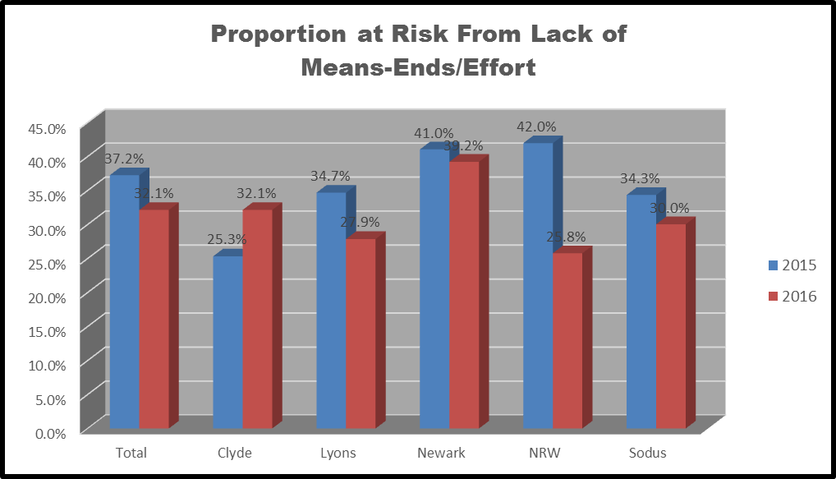
TRAUMA DISRUPTS SELF-EFFICACY:

Slide 18
Students with 2 or more adverse events were more than three (3) times more likely to lack self-efficacy.
 | ACE<2 | ACE2 or more | ratio | chi2 | p
N= | 1175 | 778
MIDDLE SCHOOL | 11.6% | 34.8% | 3.01 | 148.44 | <.001
N= | 851 | 925
HIGH SCHOOL | 10.6% | 32.9% | 3.11 | 130.3 | <.001

Slide 19
Trauma-Informed Screening and Assessment Tools
Distinct differences between trauma screening and trauma assessment tools.
Screening tools are brief, used universally, and designed to detect exposure to traumatic events and symptoms.
Functional assessments are more comprehensive and capture a range of specific information about the child’s symptoms, functioning, and support systems. A trauma assessment can determine strengths as well as clinical symptoms of traumatic stress.
If properly trained, the frontline caseworker within a child welfare setting can administer a screening tool when a child initially enters the system.
Information obtained from that screening can help the caseworker determine whether a more comprehensive trauma-informed assessment is needed.
SOURCE: https://training.cfsrportal.org/section-4-trauma-child-welfare-system/2440

Slide 21
SUPPORTS FOR STUDENTS

Slide 22
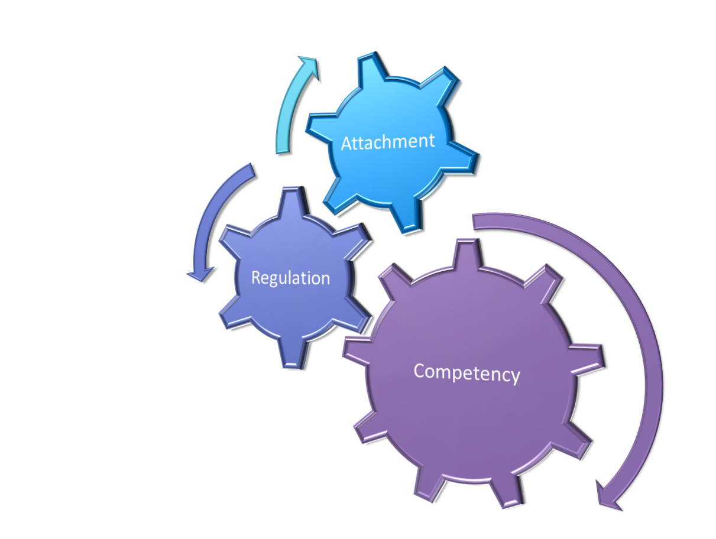
A FRAMEWORK TO HELP:
ATTACHMENT
REGULATION (SELF)
COMPETENCY
ARC is a framework for intervention with youth and families who have experienced multiple and/or prolonged traumatic stress. ARC identifies three core domains that are frequently impacted among traumatized youth, and which are relevant to future resiliency.

Slide 23
ATTACHMENT:
ATTACHMENT:
TIER 1: Positive relationships between all staff & students (clear expectations help!) Opportunities for clubs, sports & other extracurricular activities Involvement in learning!
TIER 2: Check In/Check Out Check & Connect Small groups formed for particular students Peer Mentoring
TIER 3: Counseling Individual Plans
We can organize our current interventions using the ARC Framework across a Multi-Tiered System of Supports.

Slide 24
REGULATION:
REGULATION:
TIER 1: A few clearly stated expectations with explicit instruction consistently shared among all staff Second Step taught universally to all students
TIER 2: Check In/Check Out Check & Connect Small group re-teach ( can use Second Step)
TIER 3: Counseling Individual Plans (FBA/BIP)
We can organize our current interventions using the ARC Framework across a Multi-Tiered System of Supports.

Slide 25
COMPETENCY:
COMPETENCY:
TIER 1: Strong and engaging classroom instruction for all students Differentiated instruction Skill based clubs (strategy games, gardening, cooking!) Music & Art Classes!
TIER 2: Check In/Check Out Small group re-teach ( can use Second Step) After school programs
TIER 3: Counseling Individual Plans (FBA/BIP)
We can organize our current interventions using the ARC Framework across a Multi-Tiered System of Supports.

Slide 26
TIERED FIDELITY INVENTORY & TRAUMA INFORMED SCHOOLS
The TFI is an assessment that lets us know if we are headed in the right direction in terms of intervention
It identifies a broad spectrum of systematic attributes of an effective MTSS.

Slide 27
BUILDING CAPACITY FOR STAFF

Slide 28
BOOK STUDIES & PLC’s HELPED START CONVERSATION:
(Both of these are on your resource handout)

Slide 29
TCI: Therapeutic Crisis Intervention for Schools
A crisis prevention and intervention model that was developed to assist schools in:
Preventing crises from occurring
De-escalating potential crises
Effectively managing acute crises
Reducing potential injury to children and staff
Learning constructive ways to handle stressful situation
** THERE WAS A RELATIONSHIP BETWEEN THE NUMBER OF STAFF TRAINED IN TCI AND THE NUMBER OF OFFICE DISCIPLINARY REFERRALS

Slide 30
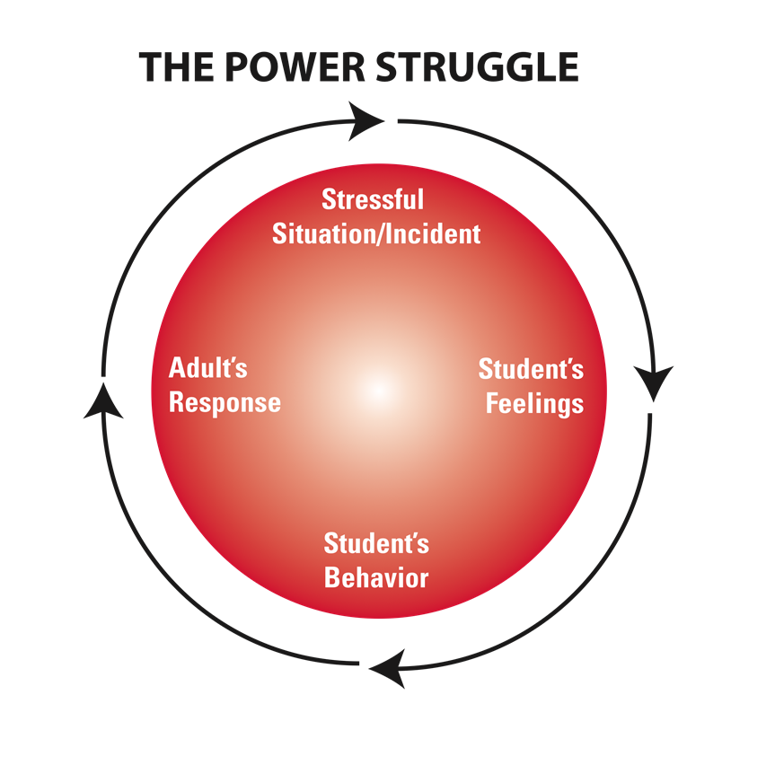
TCI TRAINS STAFF TO AVOID THE CONFLICT CYCLE & UNDERSTAND THE ANTECEDENTS TO STUDENT BEHAVIOR.
BEHAVIORS
FEELINGS
&
NEEDS
STAFF ARE TRAINED TO UNDERSTAND STUDENT BEHAVIOR AS SURFACE EXPRESSIONS OF FEELINGS & NEEDS

Slide 31
YMHFA: RECOGNIZE SIGNS & SYMPTOMS OF MENTAL HEALTH PROBLEMS & HOW TO OFFER HELP BEFORE, DURING AND AFTER A MENTAL HEALTH CRISIS.
We trained over 575 persons through a Project AWARE grant (SAMHSA Funded)
100% of participants recommended this training for others.
Find out more at mentalhealthfirstaid.org

Slide 32
What is a Trauma-Sensitive School?
A school where all students feel safe, welcomed, and supported
Where addressing trauma’s impact on learning on a school-wide basis is at the center of its educational mission
Why we need trauma sensitive schools

Slide 33
Reflection
Personal Reflection, then Whole group
What insights or new knowledge did you gain from this video and discussion?
How might you use this knowledge in your own work?
How might your school use this knowledge?

Slide 34
Adapt, not additional
IN SCHOOLS, MUCH OF WHAT IS ALREADY DONE CAN BE Integrated INTO A TRAUMA INFORMED APPROACH!!
DON’T THINK “MORE”– THINK “ADAPT CURRENT PRACTICE”

Slide 35
Thank You!
jfantigrossi@lyonscsd.org
jroscup@lyoncsd.org
@jfantigrossi and @RoscupJay on Twitter
JosephFantigrossi.com

