Slide 1
TRAUMA INFORMED SCHOOLS: A JOURNEY
Joe Fantigrossi, Ed.D., Pre K-12 Intervention Coordinator, Lyons CSD
@jfantigrossi
jfantigrossi@lyonscsd.org

Slide 2
TRAUMA IS NOT THE EVENT.
TRAUMA IS THE RESPONSE.
Each individual response to stressful event varies; trauma is a disruption of normal function and many factors can influence that response.
STOP ASKING: What is wrong with this student?
AND START ASKING: What has happened to this student?

Slide 3
Nadine Burke Harris ACES
ACE’s STUDY
TOXIC IMPACT OF STRESS
NEUROLOGY
IMPACT ON BIOLOGY/PHYSICAL HEALTH
NEED FOR A ‘PUBLIC HEALTH RESPONSE’

Slide 4
ADVERSE CHILDHOOD EXPERIENCES:
Adverse Childhood Experiences (ACEs) - potentially traumatic events with negative, lasting effects on health and well-being
ABUSE
NEGLECT
DYSFUNCTION (Family)
HANDOUT

Slide 5
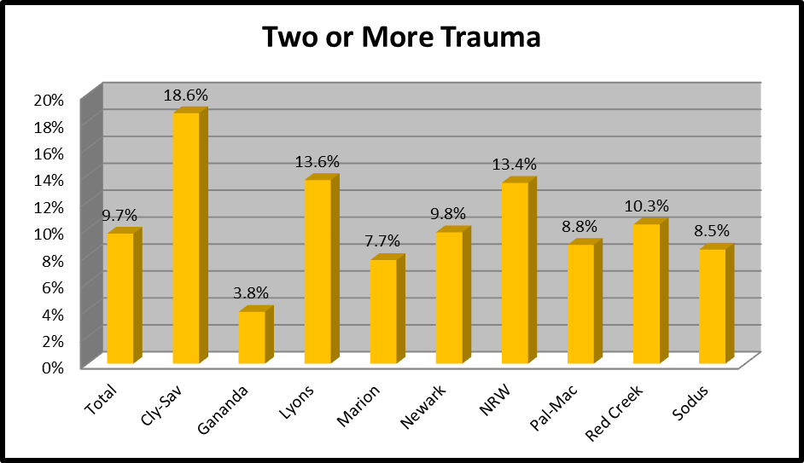
ACE’S REPORTED BY KINDERGARTEN Parents AT SCREENING:
Adverse Childhood Experiences that families commonly encounter.
How many of the following events have happened to or around this child:
-death of a parent
-parental divorce or separation
-incarceration of a parent
-drug or alcohol abuse
-mental health problems
-domestic violence
-physical neglect
-emotional neglect
-physical abuse
-emotional abuse
-sexual abuse
K READY SURVEY- Wayne County 2016
554 out of 1007 Kindergarten Students

Slide 6
LOCAL K SCREEN: Children with 2 or more “ACE” *:
3 times more likely to not calm down when upset.
Twice as likely to rarely play with children outside the family.
Twice as likely to not be able to independently button or zipper clothing.
13 times less likely to be able to focus on activity other than TV or computer.
Less than half as likely to have been breastfed for more than 6 months.
* AS REPORTED BY REGISTRANT

Slide 7
LOCAL K SCREEN: Children with 2 or more “ACE” *:
7 times more likely to have moved four or more times.
More than twice as likely to spend less than 3 hours a week in family activity.
2.5 times less likely to have a set bedtime.
5.7 times more likely to ignore rules at home.
4.3 times more likely to never read with parent/adult.
* AS REPORTED BY REGISTRANT

Slide 8
Why is this important?

Slide 9
POVERTY: CHRONIC STRESS
You can be poor and feel:
-Safe
-Loved
- Proud
When a young person or a family is enduring the chronic stress of poverty and is further strained by the acute stress of trauma, the energy required to live positively and build resiliently is significantly greater.

Slide 10
Resilience for students

Slide 11
Small Group Activity
At your tables, quietly read the handout provided at your table (Reading 1 or Reading 2)
After finishing the reading, discuss the points you felt were most important or meaningful to you with 1 or 2 other people at your table
Next, find someone from a table that read the other handout and share the most important points with them
Finally, return to your original seat for a whole group debriefing

Slide 12
SUPPORTS FOR STUDENTS

Slide 13
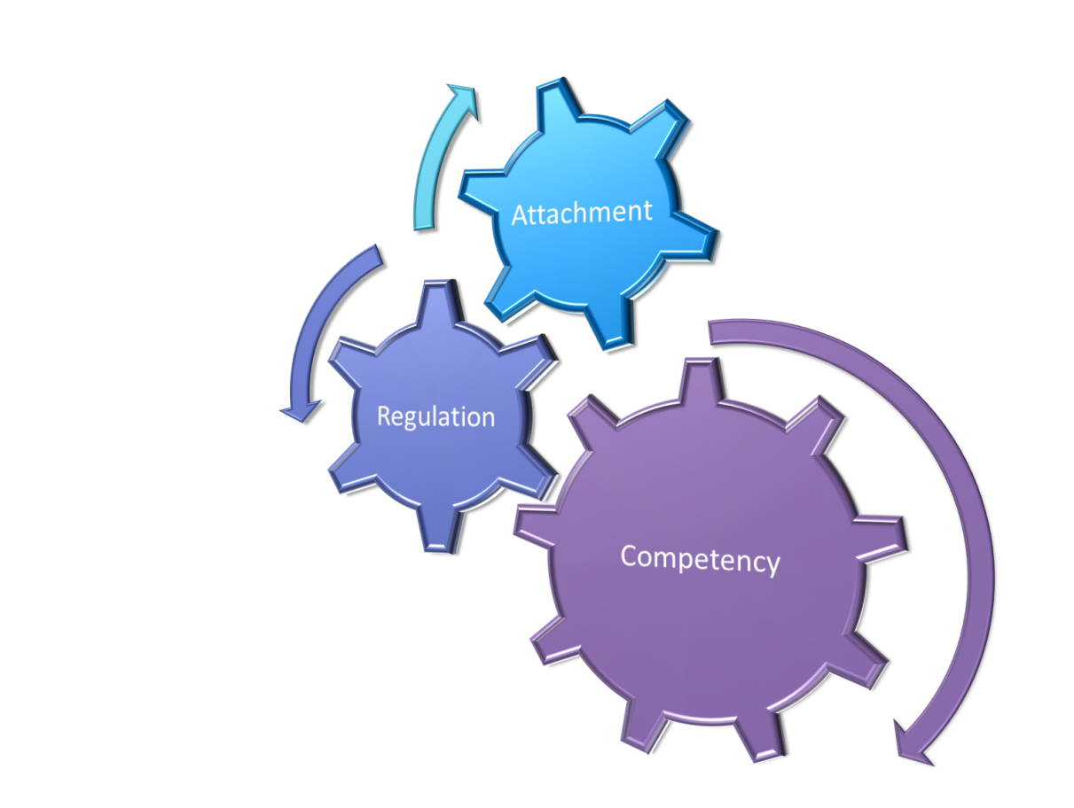
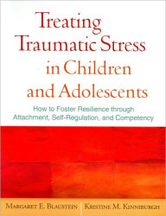
A FRAMEWORK TO HELP:
ATTACHMENT
REGULATION (SELF)
COMPETENCY
ARC is a framework for intervention with youth and families who have experienced multiple and/or prolonged traumatic stress. ARC identifies three core domains that are frequently impacted among traumatized youth, and which are relevant to future resiliency.

Slide 14
All Students:
ARC:
Attachment: Positive relationships b/w all staff & students Opportunities for extracurricular activities Involvement in learning! Positive calls home
Regulation: Clearly stated expectations with explicit instruction consistently shared among all staff Second Step or other research based SEL course taught to all students Positive reinforcement
Competency: Strong/engaging instruction Differentiated instruction Skill based clubs (strategy games, gardening, cooking!) Music & Art Classes! Goal setting
We can organize our current interventions using the ARC Framework

Slide 15
Some students:
ARC:
Attachment: Group counseling Mentoring (peer or adult) Classroom buddy Recruit into a specific club or activity; facilitate attachment to school
Regulation: Check in Sheets Small group re-teach ( can use Second Step) Youth Court Youth leadership groups
Competency: After school programs Tutoring Review classes Clubs around interest (Lego etc) Supported goal setting
We can organize our current interventions using the ARC Framework

Slide 16
Few students:
ARC:
Attachment: 1 to 1 Counseling Individual Behavior Plans (FBA/BIP) Mentoring (Adult)
Regulation: 1 to 1 Counseling Individual Behavior Plans (FBA/BIP) Therapy
Competency: 1 to 1 Counseling Individual Behavior Plans (FBA/BIP) Goal setting with increased monitoring
KEY NOTE: Individualized use of ARC moves towards clinical work that requires a high degree of expertise and specialization.
We can organize our current interventions using the ARC Framework .

Slide 17
BOOK STUDIES & PLC’s HELPED START CONVERSATION:
(Both of these are on your resource handout)

Slide 18
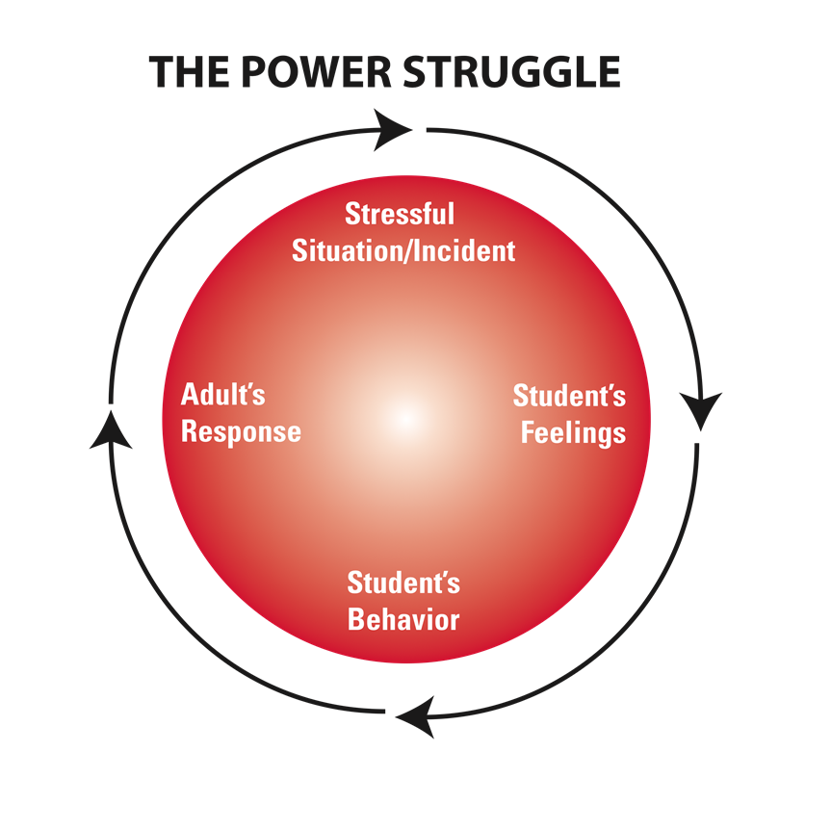
TCI TRAINS STAFF TO AVOID THE CONFLICT CYCLE & UNDERSTAND THE ANTECEDENTS TO STUDENT BEHAVIOR.
BEHAVIORS
FEELINGS
&
NEEDS
STAFF ARE TRAINED TO UNDERSTAND STUDENT BEHAVIOR AS SURFACE EXPRESSIONS OF FEELINGS & NEEDS

Slide 19
TCI: Therapeutic Crisis Intervention for Schools
A crisis prevention and intervention model that was developed to assist schools in:
Preventing crises from occurring
De-escalating potential crises
Effectively managing acute crises
Reducing potential injury to children and staff
Learning constructive ways to handle stressful situation
** THERE WAS A RELATIONSHIP BETWEEN THE NUMBER OF STAFF TRAINED IN TCI AND THE NUMBER OF OFFICE DISCIPLINARY REFERRALS

Slide 20
YMHFA: RECOGNIZE SIGNS & SYMPTOMS OF MENTAL HEALTH PROBLEMS & HOW TO OFFER HELP BEFORE, DURING AND AFTER A MENTAL HEALTH CRISIS.
We trained over 575 persons through a Project AWARE grant (SAMHSA Funded)
100% of participants recommended this training for others.
Find out more at mentalhealthfirstaid.org

Slide 21
Adapt, not additional
IN SCHOOLS, MUCH OF WHAT IS ALREADY DONE CAN BE Integrated INTO A TRAUMA INFORMED APPROACH!!
DON’T THINK “MORE”– THINK “ADAPT CURRENT PRACTICE”

Slide 22
Thank You!
jfantigrossi@lyonscsd.org
@jfantigrossi on Twitter
JosephFantigrossi.com

